Slide 1

Zomato Restaurant Analysis
Presented by: Kumari Shreesty

Slide 2

Introduction
► Zomato is one of the world's leading online food discovery and restaurant aggregation platforms, founded in 2008 by Deepinder Goyal and Pankaj Chaddah.
► The platform connects millions of customers with restaurants by providing restaurant discovery, reviews, online ordering, and food delivery services.
► With thousands of restaurants operating across multiple countries, identifying the right locations for expansion has become a critical business challenge.
► This project uses data analysis and visualization techniques to identify the most suitable countries and cities for opening new restaurants based on demand, ratings, competition, customer engagement, and pricing trends.
► The objective is to support strategic expansion decisions that maximize customer reach, revenue potential, and long-term business growth.

Slide 3
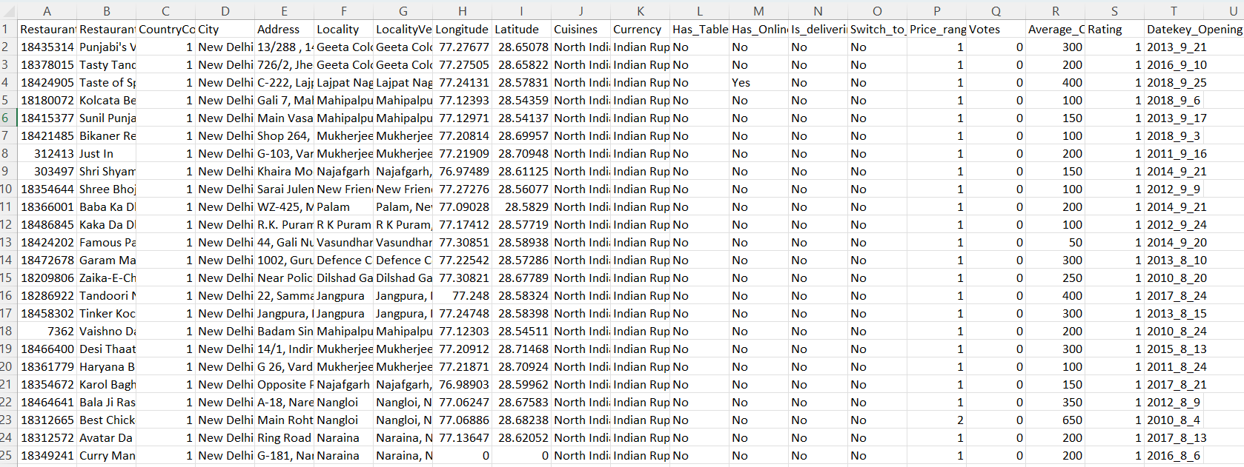
Problem Statement
You are hired as a consultant data analyst by Zomato, where the team is looking for expansion and opening more restaurants. Your task is to develop strategies/suggestions for opening newer restaurants.

Slide 4



Objective Of Project
Determine possible countries for Zomato's growth.
Analyze market patterns.
Restaurant distribution.
Customer feedback and pricing strategies to determine potential growth opportunities for Zomato.
To enhance service delivery, collect feedback and customer satisfaction statistics.

Slide 5
Data Overview
Restaurant ID: Unique identifier for each restaurant.
Restaurant Name: The name of the restaurant.
CountryCode: Country code of the location where the restaurant is situated.
City: The city where the restaurant is located.
Address: The specific address of the restaurant.
Locality: The locality or neighborhood where the restaurant is situated.
Locality Verbose: Detailed information about the locality.
Longitude: The geographical longitude coordinate of the restaurant.
Latitude: The geographical latitude coordinate of the restaurant.
Cuisines: The type of cuisine offered by the restaurant.
Currency: The currency used for transactions in the restaurant.
Datekey_opening: The date when the restaurant was opened.
Has_Table_booking: Indicates whether the restaurant has a table booking option (Yes/No).
Has_Online_delivery: Indicates whether the restaurant offers online delivery (Yes/No).
Is_delivering_now: Indicates whether the restaurant is currently delivering (Yes/No).
Switch_to_order_menu: Indicates whether users can switch to the order menu (Yes/No).
Price_range: A numeric value indicating the price range category of the restaurant.
Votes: The number of votes or ratings/(feedback) received by the restaurant.
Average_Cost_for_two: The average cost for two people dining at the restaurant.
Rating: The overall rating of the restaurant is based on user reviews.

Slide 6
Data Snapshot
Total Restaurants | 9551
Total Countries | 16
Total Cities | 140
Total cuisines | 1821
Service offered | Online Booking, Table Booking
Average Rating | 2.89
Average price in INR | ₹863

Slide 7


Methodology
Data Cleaning:
Addressed missing entries in the Cuisine column.
Eliminated unnecessary columns.
Data Enrichment:
Enhanced the dataset by incorporating country information through VLOOKUP based on the country code.
Derived year from the date key opening using text functions to facilitate analysis of temporal trends.
Descriptive Analysis:
Used pivot tables and pivot charts for dynamic summarization and visualization, enabling clear and actionable insights.
20XX
7

Slide 8
Key Metrics and Visualization
Count of Restaurants
Calculated the total number of restaurants per country and visualized the insights through charts.
It is advisable to open new restaurants in Brazil, Sri Lanka, Canada, and Australia.

Slide 9
Average number of Voters in each country:
Calculated the average number of voters per restaurant by country for comparative analysis.
A country with a significant proportion of voters indicates more interaction with customers.
Example from Chart: Indonesia, UAE, Turkey.

Slide 10
Restaurants open each year
A higher number of restaurants suggests greater consumer involvement.
Example from Chart: Years 2011, 2017, and 2018

Slide 11
Average Rating of Restaurants in each Country
It is mandatory to understand ratings of restaurants in order to develop marketing plans and assess performance.
High rating: Philippines, Turkey [These countries face major market demands].
Low rating: Canada, Singapore [Improvements must be made]

Slide 12
Top 10 Cuisines
North Indian and Chinese are most popular cuisines.

Slide 13
Average cost of two INR
Singapore is the most expensive, averaging.
India and the UAE offer the most affordable dining.
Only Singapore and the Philippines (over ) exceed this threshold.
The UK is over double the cost of the USA, showing major differences even within key markets.

Slide 14
Delivery and Table Booking Analysis
Restaurants with online delivery and table booking have slightly better average ratings.
Having an online presence caters to more people and increases the overall rating.
New restaurants should offer at least table booking or online delivery, ideally both, to improve ratings.

Slide 15
Recommendations
Focus on opening new restaurants in countries with strong potential and healthy competition.
Prioritise markets with fewer existing eateries for easier entry.
Use restaurant density analysis to spot growth opportunities and prime customer locations.
Identify major competitors to inform strategies for differentiating new venues.
Understand customer sentiment to guide improvements.
Provide quality food and smart pricing to attract and retain customers.
Implement online delivery and booking systems to boost satisfaction and ratings.

Slide 16
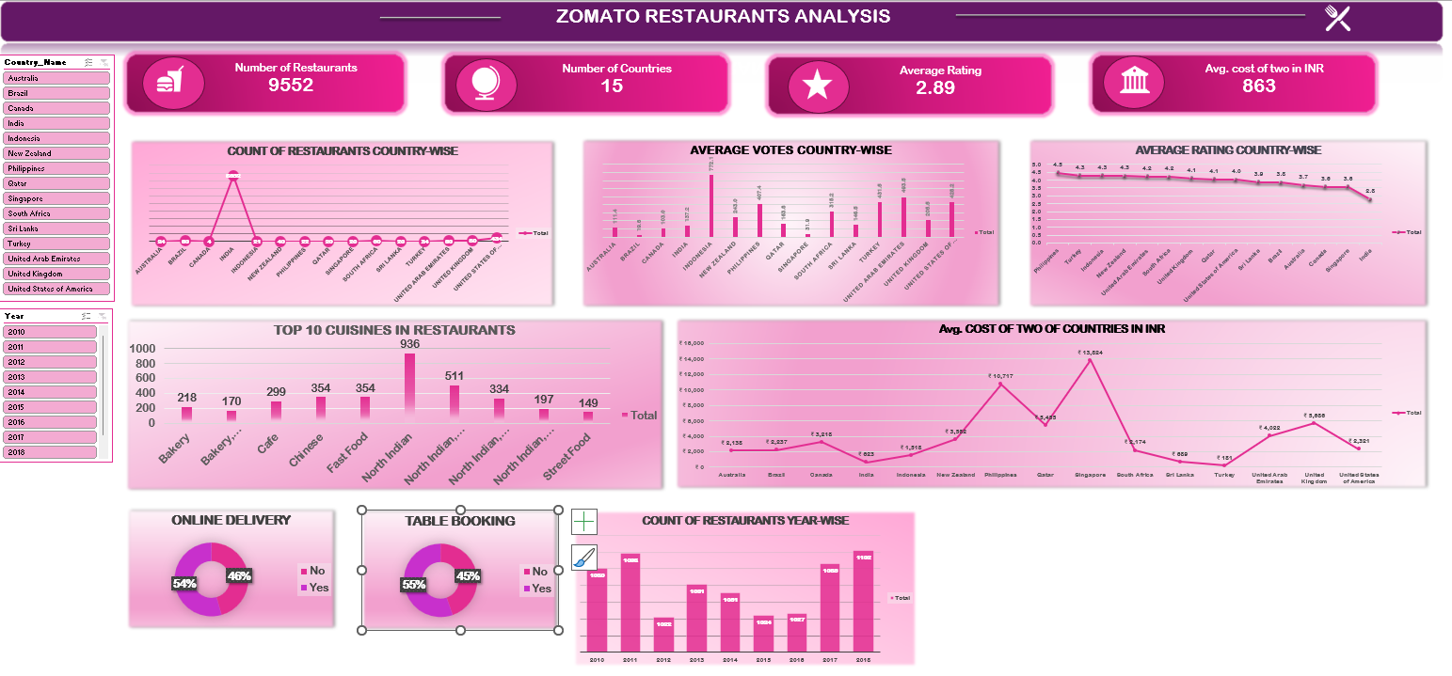
Dashboard

Slide 17
Conclusion
An in-depth examination of restaurant data has revealed several promising prospects for international growth.
We can strategically position ourselves in markets with less competition by focusing on countries with high average ratings and lower restaurant density.
North Indian, Chinese, Fast Food, Café, Bakery, Desserts, and Street Food are the top cuisines available in restaurants across all countries.
Given their high levels of consumer satisfaction, targeting cities in Sri Lanka and Indonesia has great promise.

Slide 18

Thank you

